Slide 1
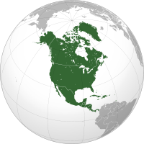
The Social Impact of World War II
Irene Kim, John So, and Sarah You
Period 5

Slide 2
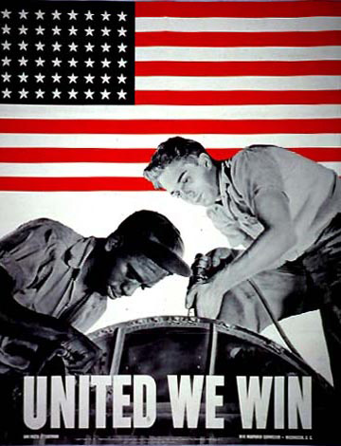
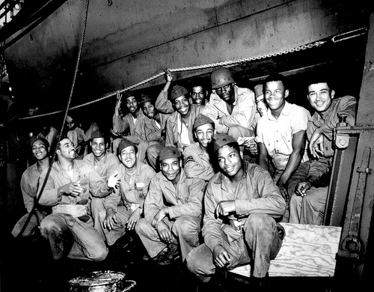
Social Impact of World War II on African-Americans

Slide 3
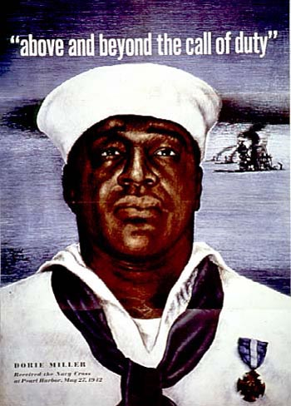
Fighting for a Double Victory
African-Americans served bravely in all theaters of the war.
Although the military remained segregated until 1948, the participation of African-Americans established a precedent for the eventual desegregation of the military.
Pressure from NAACP led Roosevelt to pledge that African-Americans would be enlisted. → numbers increased in the Army, Navy, Air Force, Marine Force, and Coast Guard.

Slide 4
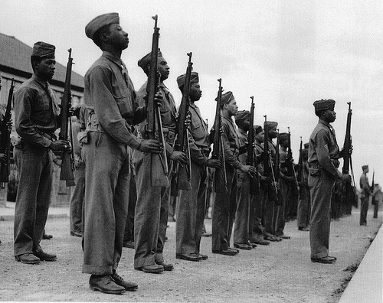
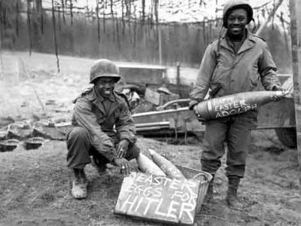
African-American sentiment during World War II
African-Americans noted the irony of fighting for democracy abroad when they were not allowed to enjoy the same privileges at home
Led to Double V campaign → advocated the end of discrimination at home and democracy aboard
European emancipation and African-American rights closely associated

Slide 5
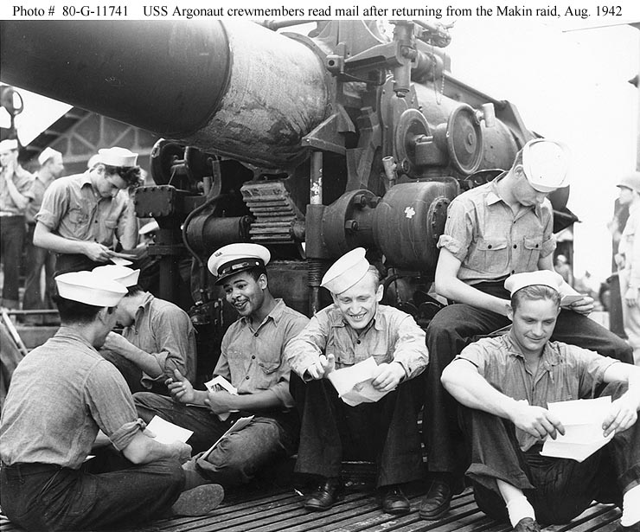
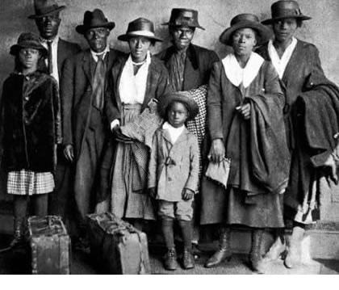
Post-World War II
African-Americans were pressured by society, soldiers, and company executives to relinquish their wartime positions.
Created organizations such as CORE (Congress of Racial Equality) and the National Association for the Advancement of Colored Peoples (NAACP) to combat discrimination.
Migrated to northern cities to find industrial jobs
Established precedent for the furtherance of civil rights for African-Americans

Slide 6
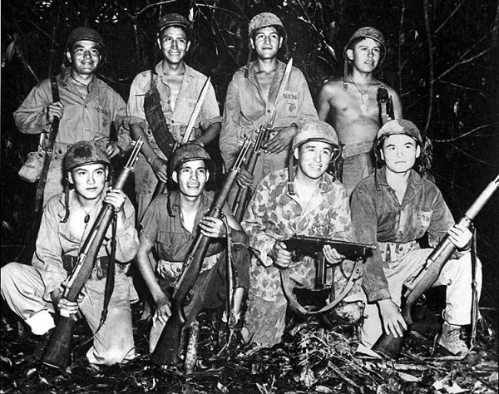
Social Impact of World War II on Native Americans

Slide 7
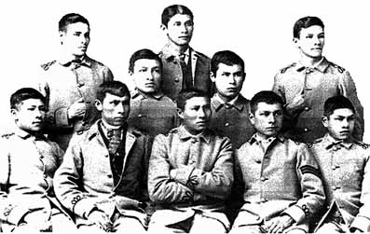
Tradition of Fighters
Native Americans had long tradition of participation preceding the outbreak of World War II
War of 1812
American West late 1800’s-early 1900’s
Spanish-American War 1898
World War I (mostly Chotaw and Cherokee)

Slide 8
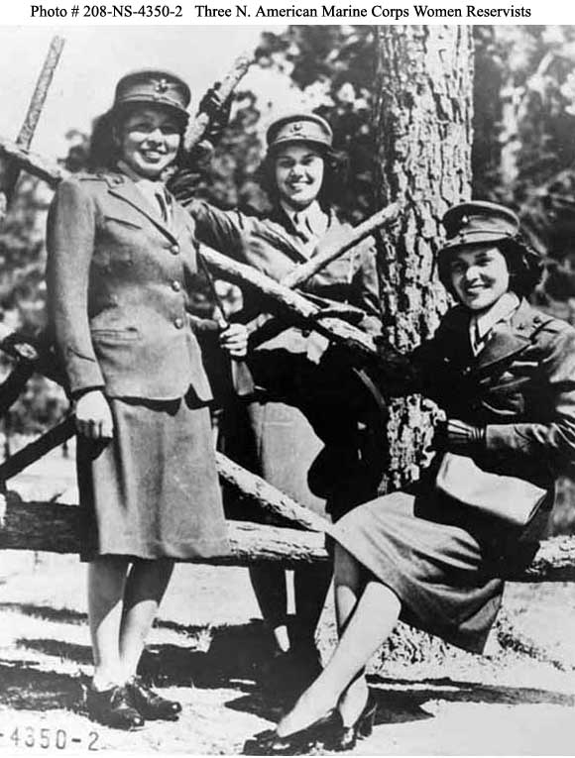
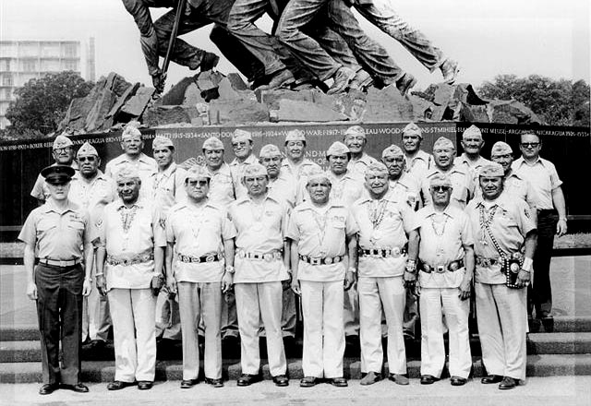
Native Americans in World War II
The outbreak of World War II initiated the emergence of Native American participation in armed forces and war production plants.
Forty percent of Native Americans voluntarily enlisted instead of being drafted.
More than 44,000 American Indians, out of a total Native American population of less than 350,000, served with distinction between 1941 and 1945.
Native American men and women on the home front also played crucial roles in the war effort → Invested more than 50 million in war bonds, also contributing significantly to the Red Cross and Navy relief societies.

Slide 9
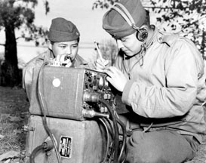
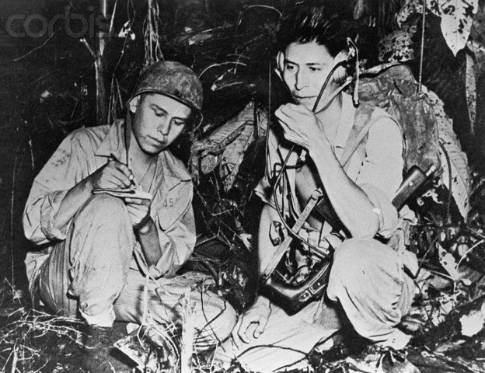
Navajo Code Talkers
Contributed significantly in Guadalcanal, Tarawa, Peleliu, Iwo Jima
The Navajo Code Talkers transmitted and translated messages by telephone and radio in their own language that the Japanese were never able to decipher.
Navajo is an unwritten, extremely complex language (no alphabet or symbols), that is unintelligible to anyone who has not had extensive training. Only about thirty non-Navajos could understand the language at the beginning of World War II, none of them Japanese.

Slide 10
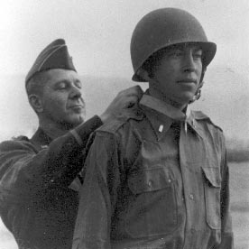
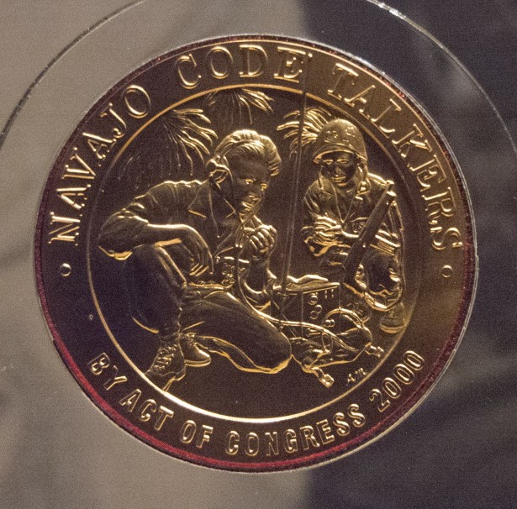
Impact of World War II on Native Americans
The role of Native Americans in World War II provided new opportunities and disrupted conventional roles.
Many adapted permanently to cities → forged a new Pan-American identity.
Negative impact → lessened the prestige of cultural/tribal influence, undermined the security of the reservation and the Native American way of life.
Positive impact → increased standard of living, health care, job opportunities.

Slide 11
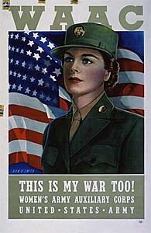
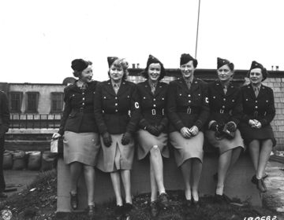
Social Impact of World War II on women

Slide 12
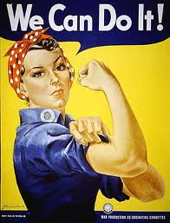
Changes on the Home Front
Men were drafted to serve in the army
Labor shortage in war industries
Women entered the work force
Encouraged by “Rosie the Riveter”
The ideal woman worker
War industries
Produced necessary equipment for war
Planes, bombs, tanks, and other weapons

Slide 13
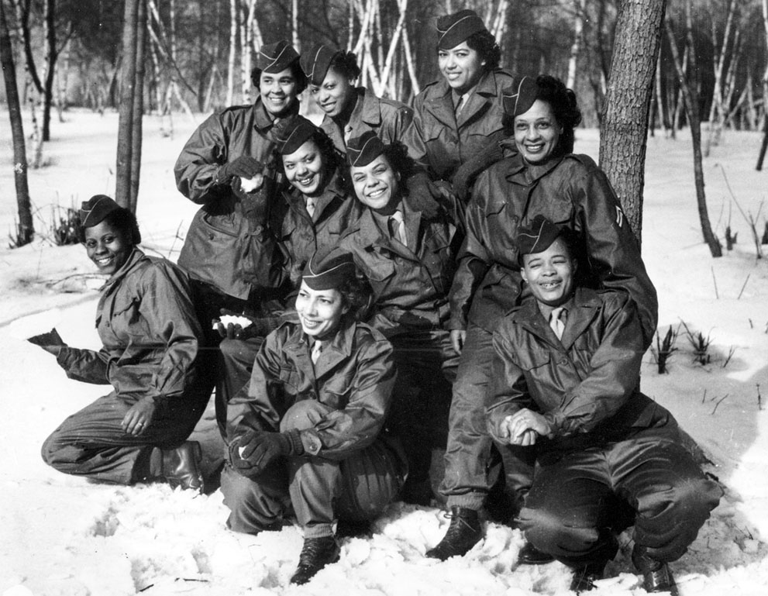
Military Contribution
Served in the United States Armed Forces (350,000 women)
Women’s Army Corps (WAC)
The Women Air Force Service Pilots
the Navy (WAVES)
Marine Corps Women's Reserves.
Volunteered as nurses
Army and Navy Nurse Corps, the Red Cross
By the end of the war, more than 2 million women had worked in war industries.
Members of WAC at Camp Shanks, New York

Slide 14
Lasting Impact of WWII
Women’s expectations changed
Work force
A change in their traditional role as women
More independent, and capable of these jobs
War ended and men came back from war
Many went back to their traditional role as wives and mothers
the new image of women was temporary
However, women in the work force during World War II continued into the future, advancing the movement for greater gender equality

Slide 15
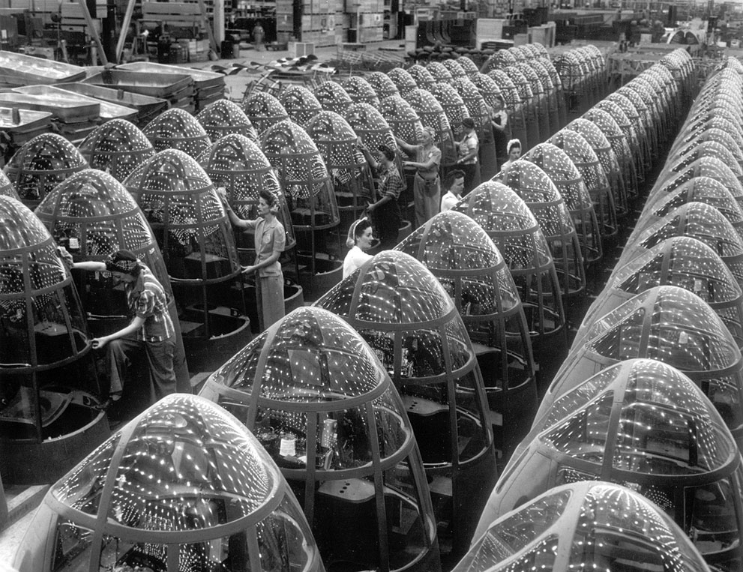
Women workers groom lines of transparent noses for the A-20J attack bombers at Douglas Aircraft's in Long Beach, California, in October of 1942. (AP Photo/Office of War Information)

Slide 16
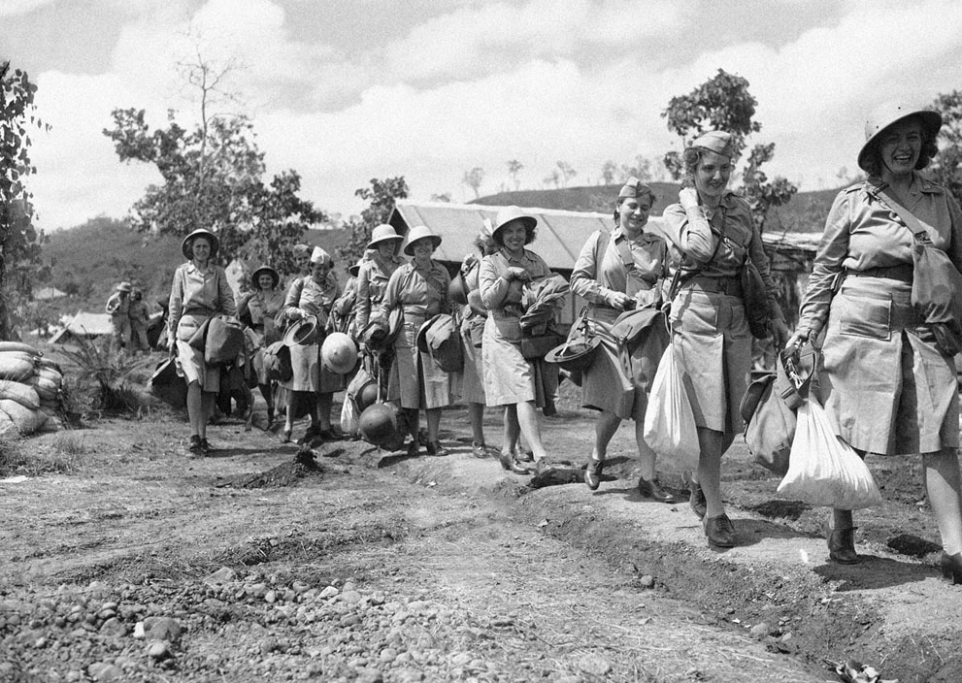
The first contingent of U.S. Army nurses to be sent to an Allied advanced base in New Guinea carry their equipment as they march single file to their quarter on November 12, 1942.

Slide 17
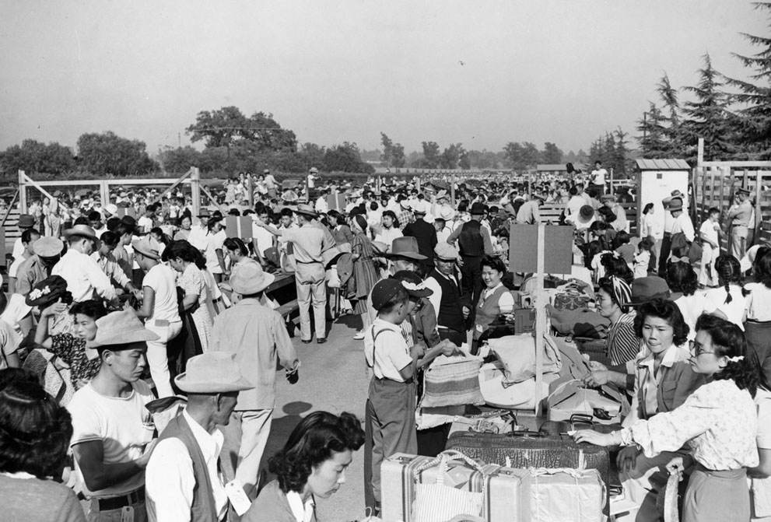
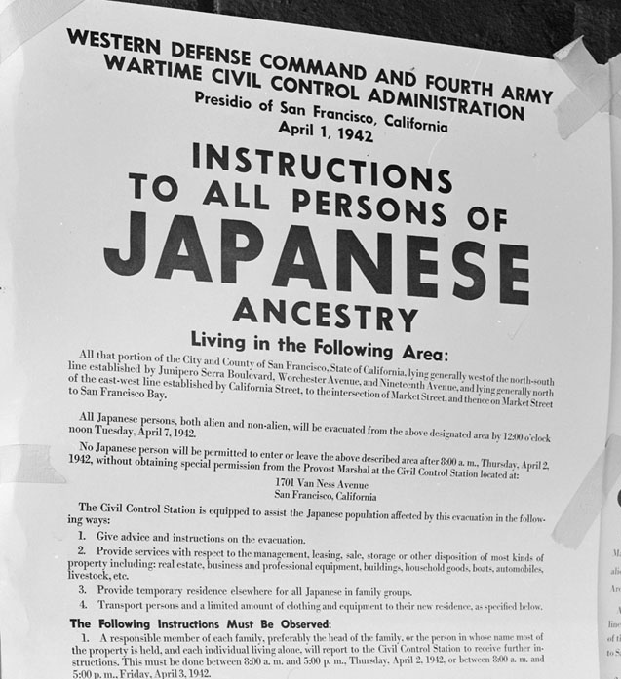
Social Impact on Japanese
Bombing of Pearl Harbor
Construction of internment camps → run by the federal War Relocation Authority
more than 110,000 Japanese Americans were relocated into internment camps
Massive exclusion zone along the west coast
deprived of their homes, jobs, and constitutional and legal rights
Japanese American property was not returned to them after the war and the internment
The last internment camp closed in 1946

Slide 18
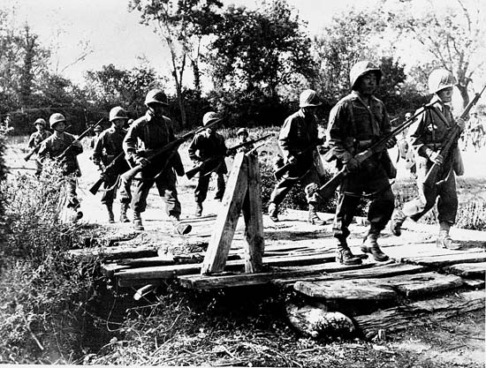
Social Impact on Japanese
Combat units of Japanese Americans
The 442nd Regimental Combat Team
Assembled in 1944 by the United States
More than 30,000 served in the U.S. military
Some interned Japanese Americans organized a draft resistance movement
protested the Selective Service Act

Slide 19
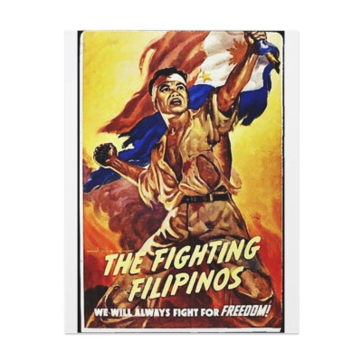
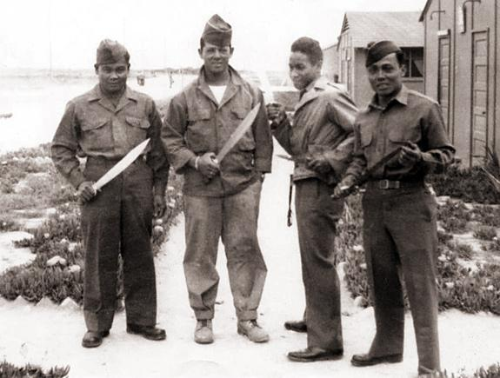
Social Impact on Filipinos
Filipinos were barred from joining the armed forces
1942, President Roosevelt allowed Filipinos to be drafted into military service
Filipinos fought side by side with the Americans in Europe and Asia
earned the acceptance and admiration of the American public
the Filipinos had proven their right to become citizens of the United States
Nationality Act of 1940
allowed the noncitizens who joined the military to avail of citizenship.

Slide 20
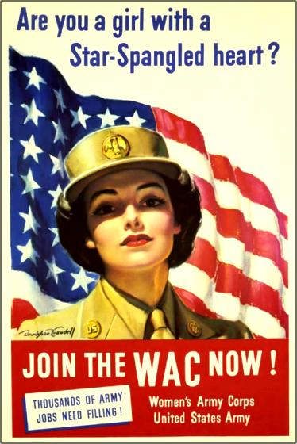
Latinas in the military
Latinas enlisted in the Women’s Army Corps
200 Puerto Rican women formed part of the Women's Army Corps
Latinas worked in the defense industry during World War II
traditionally, they had been excluded from such jobs
the war demanded new workers
worked in shipyards, armament factories, and aircraft facilities
Formerly limited to jobs as maids, garment workers, or farm laborers
Mexican women found higher wages and opportunity to intermingle with female workers of other racial groups

Slide 21
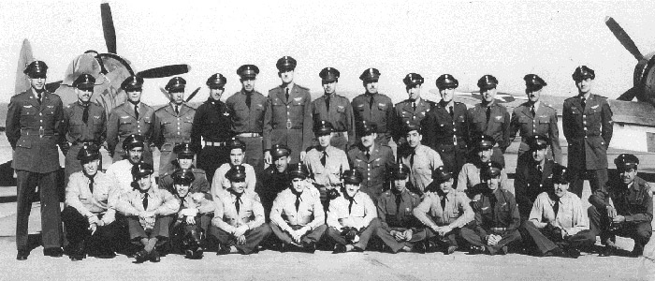
Latinos in the Military
500,000 Latinos served in the U.S. armed forces.
New Mexico National Guard contained a heavy representation of both Hispanic officers and enlisted men
Spanish-speaking abilities were useful in the Philippines
Post-World War II → men and women made astounding civil rights advancements
Ex. school desegregation, voting rights, and basic civil rights
the G.I. Forum and the Mexican American Legal Defense and Educational Fund (MALDEF)
U.S. came to appreciate Puerto Rico’s military importance in the Caribbean.

Slide 22
Conscription
1920 - The National Defense Act establishes a system of voluntary recruitment
1940 - Congress enacts the Selective Training and Service Act
All males between the ages of 21 and 35 are ordered to register for the draft
As World War II progresses, the draft age is lowered to 18
1941 - Congress gives the president power to send draftees anywhere in the world removing the distinctions creating one army made up of all
1947 - President Harry S. Truman recommends to Congress that the 1940 - Selective Training and Service Act expire and that the level of required military forces be maintained by means of voluntary enlistments

Slide 23
Works Cited
http://www.kidport.com/RefLib/WorldHistory/WorldWarII/WorldWarIIEffects.htm
http://www.theatlantic.com/infocus/2011/09/world-war-ii-women-at-war/100145/
http://collections.mnhs.org/visualresources/image.cfm?imageid=186313&Page=1&Keywords=virginia%20Mae&SearchType=Basic
http://www.mnhs.org/library/tips/history_topics/133women_military.htm
http://www.womensmemorial.org/H&C/History/wwii.html
http://www.archives.gov/atlanta/education/resources-by-state/wwii-women.html
http://www.nps.gov/pwro/collection/website/rosie.htm
http://www.archives.gov/research/arc/topics/japanese-americans/
http://www.shsu.edu/~his_ncp/NAWWII.html
http://www.history.navy.mil/faqs/faq61-1.htm
http://learn.uakron.edu/beyond/ww2_civilRights.htm

